Slide 1

Software Project Management Presentation
Enchanted
Movie
Presentation Contents —
Function Introduction
Project Management Plan
2023 March 30
- Team Members -
王思敏 202230310231 瞿茹芸 202230310215 许蒙蒙 202230310259

Slide 2
Project Introduction
Enchanted Movie is a multifaceted iOS movie application that combines movie viewing, ticket booking, information browsing, and community interaction in one convenient platform. It is dedicated to delivering a superb movie experience for enthusiasts while staying ahead in the ever-changing cultural and commercial landscape. By blending cutting-edge technology and personalized design, Enchanted Movie offers users a range of functions and experiences, including:
Sleek and user-friendly interface
Social features
Custom playlists
User reviews
Search function
Movie information
Review community
Movie ticketing
Daily recommendations
- Enchanted

Slide 3
Project Scope Management
Activity | Description
Requirements Analysis | Identify and document the software requirements, including both functional and non-functional requirements
Framework Design | Design the software architecture and framework to provide a structure for software development
UI Design | Design the user interface and user experience of the software
Software Functionality Development | Develop the software functionality based on the requirements and design
Software Functionality Testing | Test the software functionality to ensure that it meets the requirements and is free from defects
Classroom Demonstrations | Demonstrate the software in a classroom setting to ensure that it meets the educational needs and requirements
Activity | Description
Documentation Creation | Create relevant documentation throughout the development process
First Source Code Inspection | Verify the operation of the sub-functional modules through a code inspection
Second Source Code Inspection | Evaluate the complete system's performance after the functional modules have been integrated through a code inspection
Submission of Program Source Files | Submit the program source files after the completion of the inspections
Limitations | This project is limited to the iOS system and does not entail any provisions for adaptability to other operating systems outside of iOS, nor for future software updates beyond the scope of the project.
- Scope Planning -

Slide 4
Scope Definition
Enchanted Movie
User Interface Design
Movie Information Management
User Management
Social Functions
Playlist and Viewing History Management
User Ratings and Comments
Movie News and Ticketing
Determine the overall style and theme of the app
Obtain and organize movie materials
Determine the storage method and structure of user information
Develop user follow functions
Develop user-customizable playlist functions
Develop comment functions for movies
Obtain and organize movie-related informations
Design each page and element of the app
Determine the storage method and structure of movie information
Develop user registration and login functions
Develop user communication and sharing functions
Implement functions for viewing user viewing history
Implement functions for replying to comments
Design and develop online ticketing functions
Create prototypes and conduct user testing and feedback
Develop programs for importing and updating movie information
Implement user information editing
Implement user dynamic and notification functions
Design and develop daily recommendation functions
Design filtering functions for comments
Implement functions for purchasing tickets
Optimize the interaction and user experience
Implement search and filtering functions for movie information
Determine user privacy and security policies
Design and develop a movie review community
Develop functions for viewing movie news

Slide 5

Technical Process
- The front-end interface of the application will be built using the SwiftUI framework based on the Swift programming language, and the back-end of the application will be built using the Django framework based on the Python programming language.
- The project coding will adhere to a uniform indentation format, camel case naming convention, standardized comments, and code formatting.
- Software testers are required to perform unit testing based on the provided testing documents.
The following documents are required to be delivered upon project completion:
Software project management plan
Requirements analysis report
Design report
Testing documents
Other documents (As we need)
Enchanted
Movie —
Enchanted Movie Application

Slide 6
Resource Requirements
Category | Resource Requirement
Front-end development tool | Xcode
Back-end development tool | Pycharm
Other development tools | Docker、Git
Collaboration platforms | Wolai、GitHub
Development devices | Two Windows PCs one MacBook one CentOS7 server
Classroom Demonstrations | The independent development location determined by the team
- Resource Requirements -

Slide 7
Stuffing Management Plan
The project team is composed of a project manager, a front-end developer, two back-end developers, a quality assurance personnel, a risk management and a recorder. Xu Mengmeng is responsible for front-end development and quality assurance personnel, while Wang Simin and Qu Ruyun handle back-end development. In addition, Wang Simin also serves as the risk management personnel, while Qu Ruyun takes on the role of recorder.
Name | Title | Wolai ID
Xu Mengmeng | Front-end Developer Quality assurance personnel (or Project Manager) | Enchanted
Wang Simin | Back-end Developer Risk management personnel (or Project Manager) | Ophelia
Qu Ruyun | Back-end Developer Recorder (or Project Manager) | qry
- Personnel position schedule -

Slide 8
Technical Process
Milestone List
Milestone | Description | Date
Topic selection | Based on the level of demand for application software in various fields among the public, a questionnaire will be selected and a topic will be determined | 2023.03.01
Requirement Formulation | The requirements for Enchanted Movie will be based on design and will maximize feasibility | 2023.03.08
Software Design | The front-end UI and theoretical functionality of the software will be designed | 2023.03.14
Project Coding | Software Coding： - FE page construction: 04.01-05.04 - BE function development：04.05-05.04 - FE and BE integration：05.05-05.10 | 2023.04.01
Software Testing | The functionality of the software will be tested for completeness, and any related errors will be identified and corrected | 2023.05.10
Project Optimization | Based on the results of testing, the project's functionality will be optimized and performance improved | 2023.05.15
- The chart below presents the major milestones and their respective schedule for the Enchanted Movie project. It is important to note that this chart solely encompasses the parent requirement milestones, such as requirements gathering and design or coding phases.
- However, there may be additional, smaller milestones that are not included in the table but can be found in the sub-requirement details available on the shared collaboration platform.
Enchanted
Movie —
- Milestone List

Slide 9
Task Decomposition & Time Management
Based on personnel allocation, the following task division has been established for the Enchanted Movie project:
Each team member will work as a development engineer, collaborating on front-end and back-end construction, testing, and documentation writing.
The project manager will allocate sub-requirements and oversee the handling of parent requirements.
Each team member will develop their assigned task module, and the project manager will conduct a final review.

Slide 10
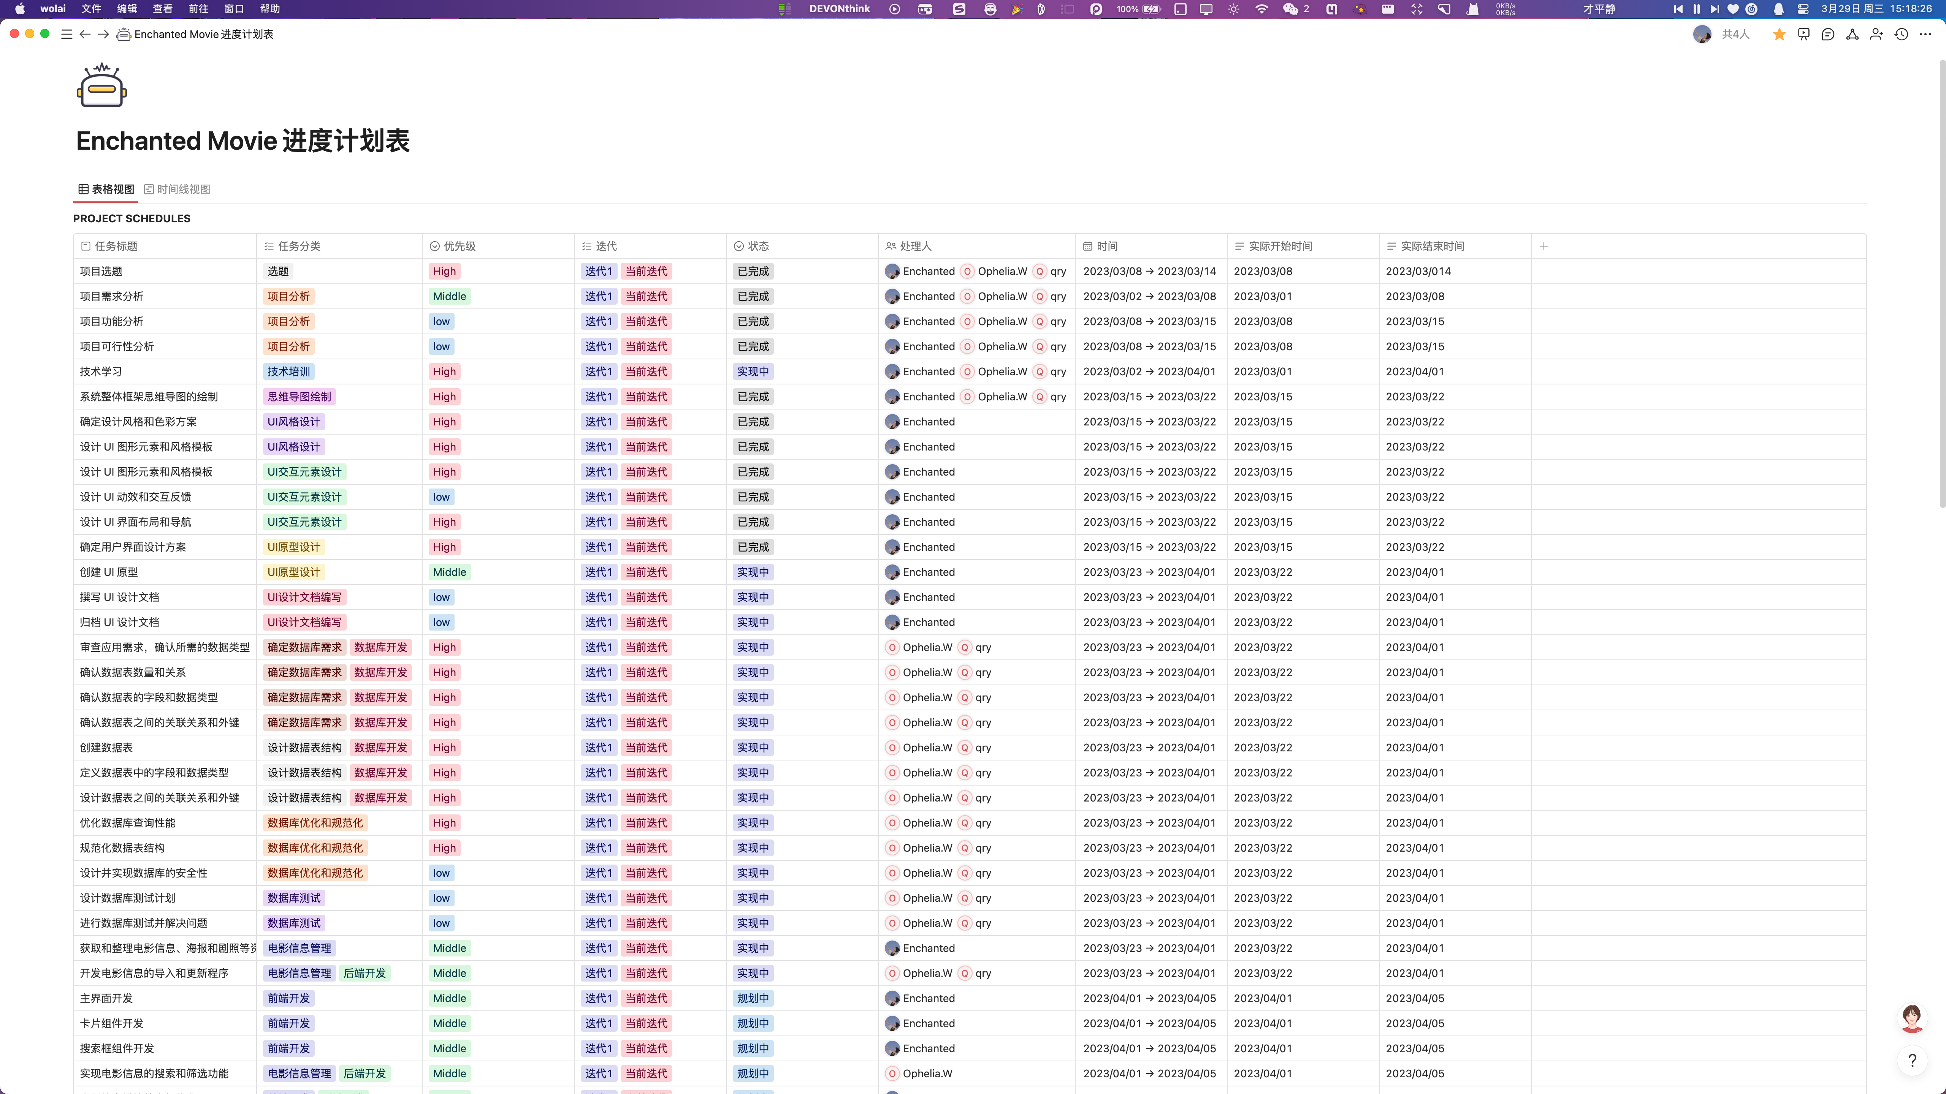

Slide 11
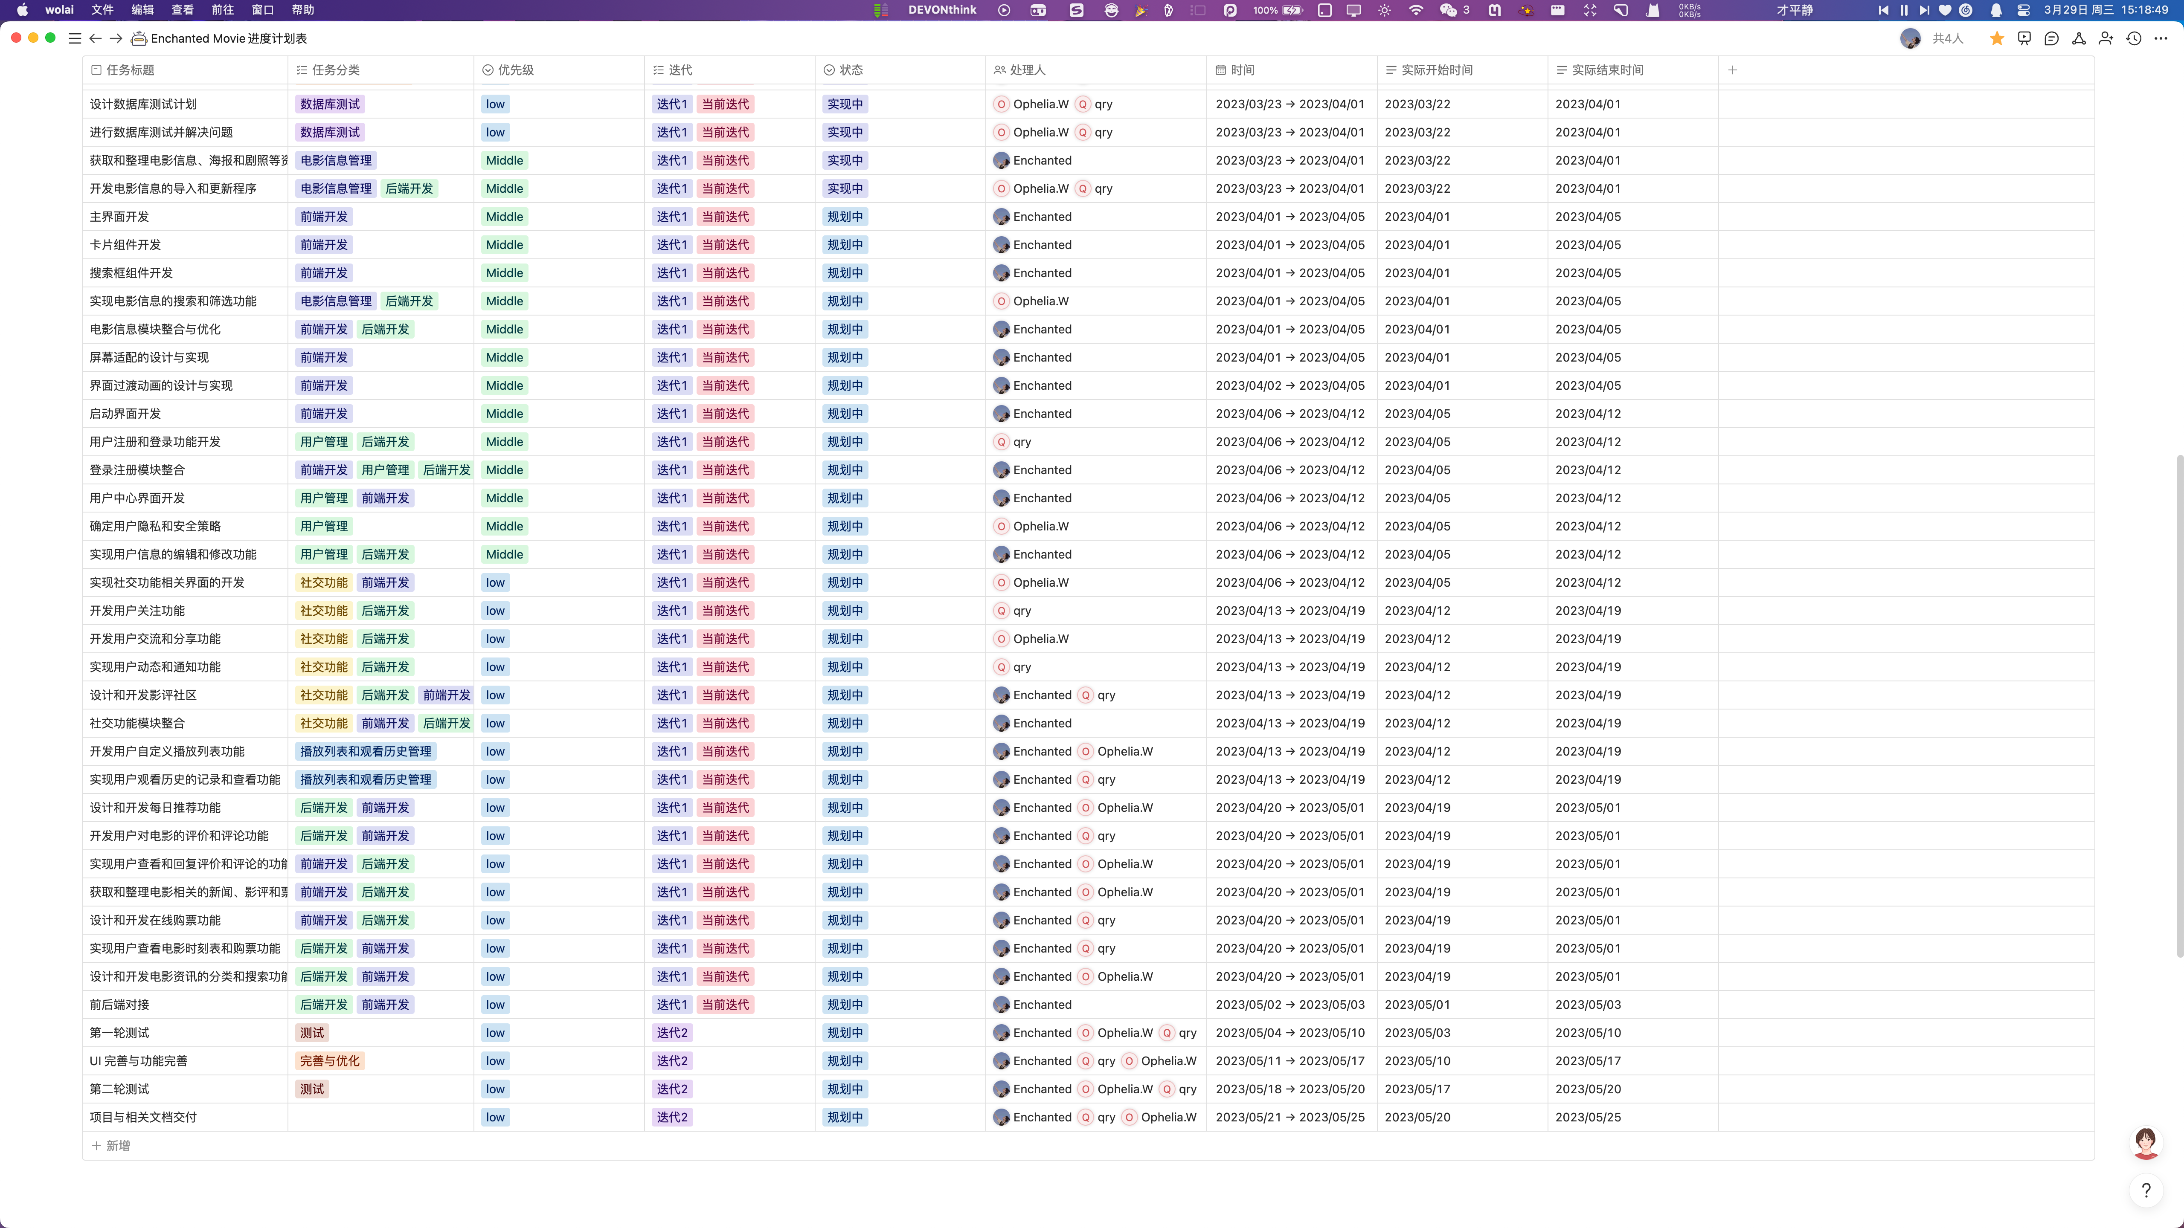

Slide 12
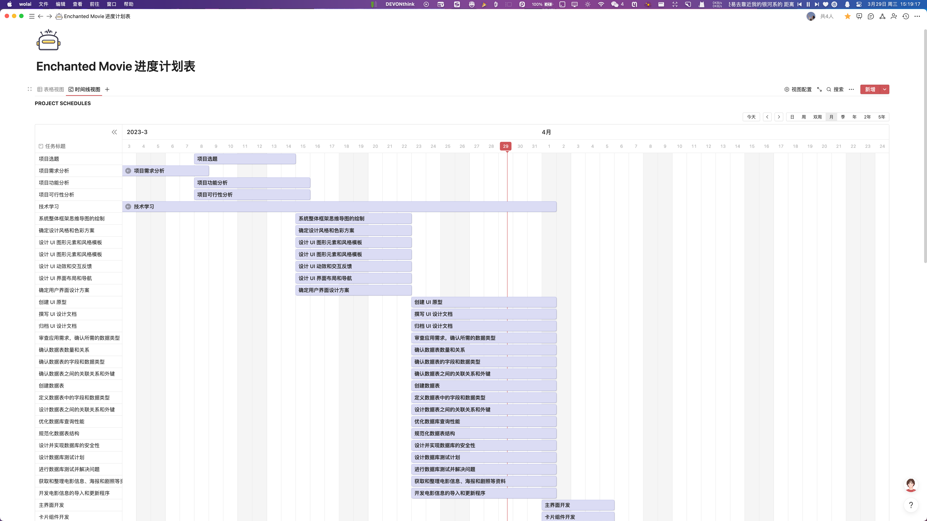

Slide 13
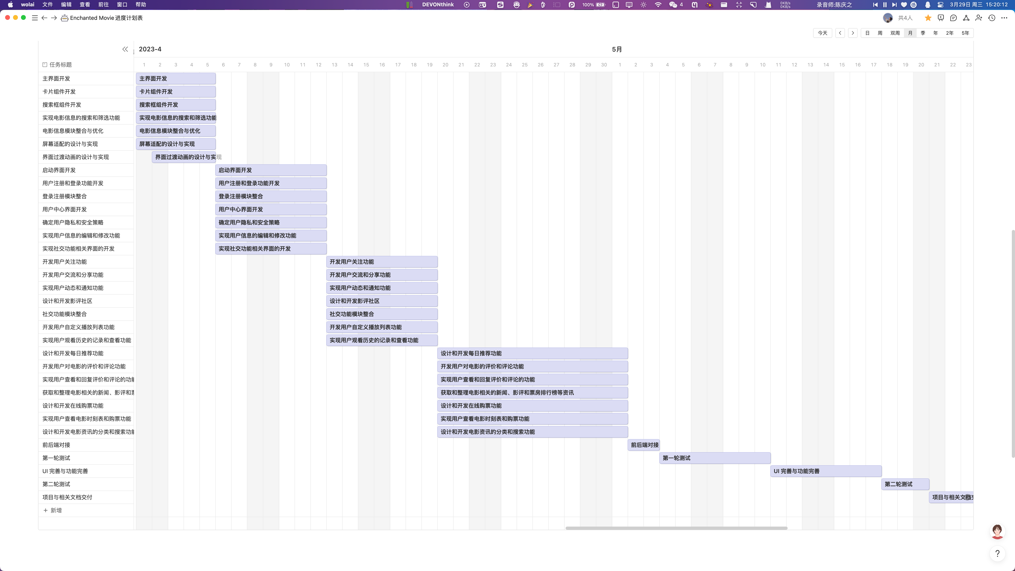

Slide 14
Risk Management Plan
Risk Category | Probability | Impact | Risk Description | Preventive Measures | Corrective Measures
Requirements Analysis | Medium | Medium | A core team member may temporarily leave the project due to health reasons. | Establish a multi-level team cross-training mechanism to ensure that multiple team members can take over the core member's responsibilities. | Prepare backup personnel for the core member to ensure that core functions can continue when necessary.
Framework Design | High | High | The development team may encounter technical difficulties due to the use of new technology. | Establish a technical group including external team members to be able to solve problems quickly when they arise. | Regularly schedule technical reviews to ensure the project is on schedule, and adjust technical solutions if necessary.
UI Design | High | High | The project may face delays due to personnel changes or technological reasons. | Establish an executable timetable so that everyone knows the deadline for their tasks. | Regularly evaluate progress and find solutions to ensure that the project can proceed as planned.
Software Functionality Development | Medium | High | Frequent changes in requirements may result in project delays or exceed budgets. | Develop a clear requirement change process, clarify the person responsible for the change, and ensure that each change is sufficiently approved and evaluated. | Review changes to avoid unnecessary changes, and timely incorporate necessary changes into the project management plan, and conduct sufficient communication and coordination to avoid unnecessary delays and additional costs.
Software Functionality Testing | Low | Low | The project may face financial problems due to insufficient funds or budget overruns. | Regularly monitor the budget and seek ways to reduce costs. | Regularly conduct budget reviews and take corrective action when necessary.
Classroom Demonstrations | Low | High | In the project management process, improper management decisions or lack of resources, communication, and leadership abilities may lead to project progress being blocked or major errors occurring. This may ultimately result in project delays, cost overruns, or quality issues, leading to project failure. | Provide sufficient resources and power for the project manager to effectively manage and control project progress, cost, and quality; establish effective communication mechanisms and processes to ensure smooth communication between project team members. | Strengthen communication and coordination in the event of management errors; seek support and solutions in the event of resource shortages; adjust plans and resources promptly to ensure project progress and completion quality in the event of schedule delays.

Slide 15
Quality Management Plan
The Enchanted Movie project has the following quality roles and responsibilities:
The project manager approves all quality standards for the project, reviews project tasks and deliverables, and ensures that they meet approved quality standards. The project manager also signs off on the final acceptance of project deliverables.
Along with the project manager, quality inspection personnel Xu Mengmeng are responsible for the overall quality management of the project. They implement the quality management plan, ensure that all tasks, processes, and documents conform to the plan, and work with the project team to establish acceptable quality standards. The project manager communicates and tracks all quality standards in real-time.
The quality inspection personnel recommend tools and methods for tracking quality and standards and create and maintain quality control and assurance logs for the entire project.
The project team and stakeholders assist the project manager and quality inspection personnel in establishing acceptable quality standards and communicate any concerns about quality to the project manager.
- Enchanted Movie -

Slide 16
Communications Management Plan
Communication Method | Description
Tencent Meeting | The project manager schedules meetings in advance using the Tencent Meeting app, and sets group announcements to remind team members to attend. Permissions are set during the meeting and the content is recorded for subsequent review. After the meeting, the recorder uploads the meeting minutes to the meeting document on the Wolai platform.
Wolai | Wolai provides a short communication service for team members to discuss project requirements. Topics should be closely related to the requirements and provide solutions. The format should be clear and complete, and members should not change the comments of other members without permission. If changes are necessary, team members and project managers must be informed, and the project manager must monitor the progress of the discussion.
WeChat | The format can be flexible. If there are any special questions or requests related to the project, team members can "@" the project manager in Wolai.
- Communication Method -

Slide 17
Communications Management Plan
Communication Type | Description | Frequency | Format | Participants/Distribution | Deliverable | Owner
Weekly Status Update | Summarizes project status in Wolai | Weekly | Wolai | Project team | Status report | Project Manager
Team Meeting | Records progress and team reports on Tencent Meeting | Weekly | Tencent Meeting | Project team | Meeting presentation | Project Manager
Iteration Review | Reviews iteration progress and provides feedback in Wolai | End of each iteration (2 iterations in total) | Wolai | Project team | Iteration document | Project Manager
Monthly Review | Evaluates stage progress and plans for the next stage | Monthly | Wolai | Project team | Completion report | Project Manager
Technical Design Review | Reviews technical and design aspects as per requirements | As needed | Wolai | Project team | Online presentation | Project Manager
- Communication Management Details Table -

Slide 18
Cost Management
Our team used a bottom-up approach to estimate the costs for this project. We estimated the cost of each individual task and then aggregated the costs to develop an overall cost estimate. Our cost estimation for this project is as follows:
Task | Duration (days) | Cost(RMB)
Requirements gathering | 5 | 2,500
Design and development planning | 10 | 5,000
Frontend development (Xu Mengmeng) | 60 | 20,000
Backend development (Wang Simin) | 60 | 20,000
Backend development (Qu Ruyun) | 60 | 20,000
Testing and quality assurance | 10 | 5,000
Deployment and release | 5 | 2,500
Total | 60 | 75,000
- Cost Estimation -

Slide 19
Cost Management
Based on the above cost estimation, we have developed a budget for the project. The budget includes all the costs associated with the project, such as salaries, hardware, software, and other expenses.
Expense Category | Estimated Cost (USD) | Expense Category
Salaries | 60,000 | Salaries
Hardware and software | 10,000 | Hardware and software
Other expenses | 24,000 | Other expenses
- Cost Budget -

Slide 20
Thanks
- Enchanted Movie -

